Slide 1
REAL TIME FACE RECOGNITION
BASED
ATTENDANCE SYSTEM
Advisor Name
Ashutosh Parida
Notes:
BY KHUSHBU KHAN & ISAN SAHOO
B-TECH PROJECT MID-SEM PRESENTATION 2011
BY KHUSHBU KHAN & ISAN SAHOO
1

Slide 2
GROUP MEMBERS AND THEIR ROLES :
AISWARYA : Team Lead
IMRAN : Developer
SARBAJIT : Developer
KAJAL : Database
ANKIT : Tester

Slide 3
GIST :
In this project, we would be building an automated face
recognition based attendance system that aims to create an
efficient class attendance system using techniques for facial
Recognition and storing the same in MongoDB database.
We would be using a web UI to display the attendance stored in the database.

Slide 4
Languages and Tools used :-
Python Language
OpenCV library
Haar Cascade XML
Face-recognition library
MongoDB database
FastAPI
Notes:
BY KHUSHBU KHAN & ISAN SAHOO
B-TECH PROJECT MID-SEM PRESENTATION 2011
BY KHUSHBU KHAN & ISAN SAHOO
4
4

Slide 5
Steps to be performed :-
Typically this project can be divided into 4 stages :---
Dataset Creation
Face Detection
Face Recognition
Attendance Updation
Notes:
BY KHUSHBU KHAN & ISAN SAHOO
B-TECH PROJECT MID-SEM PRESENTATION 2011
BY KHUSHBU KHAN & ISAN SAHOO
5
5

Slide 6
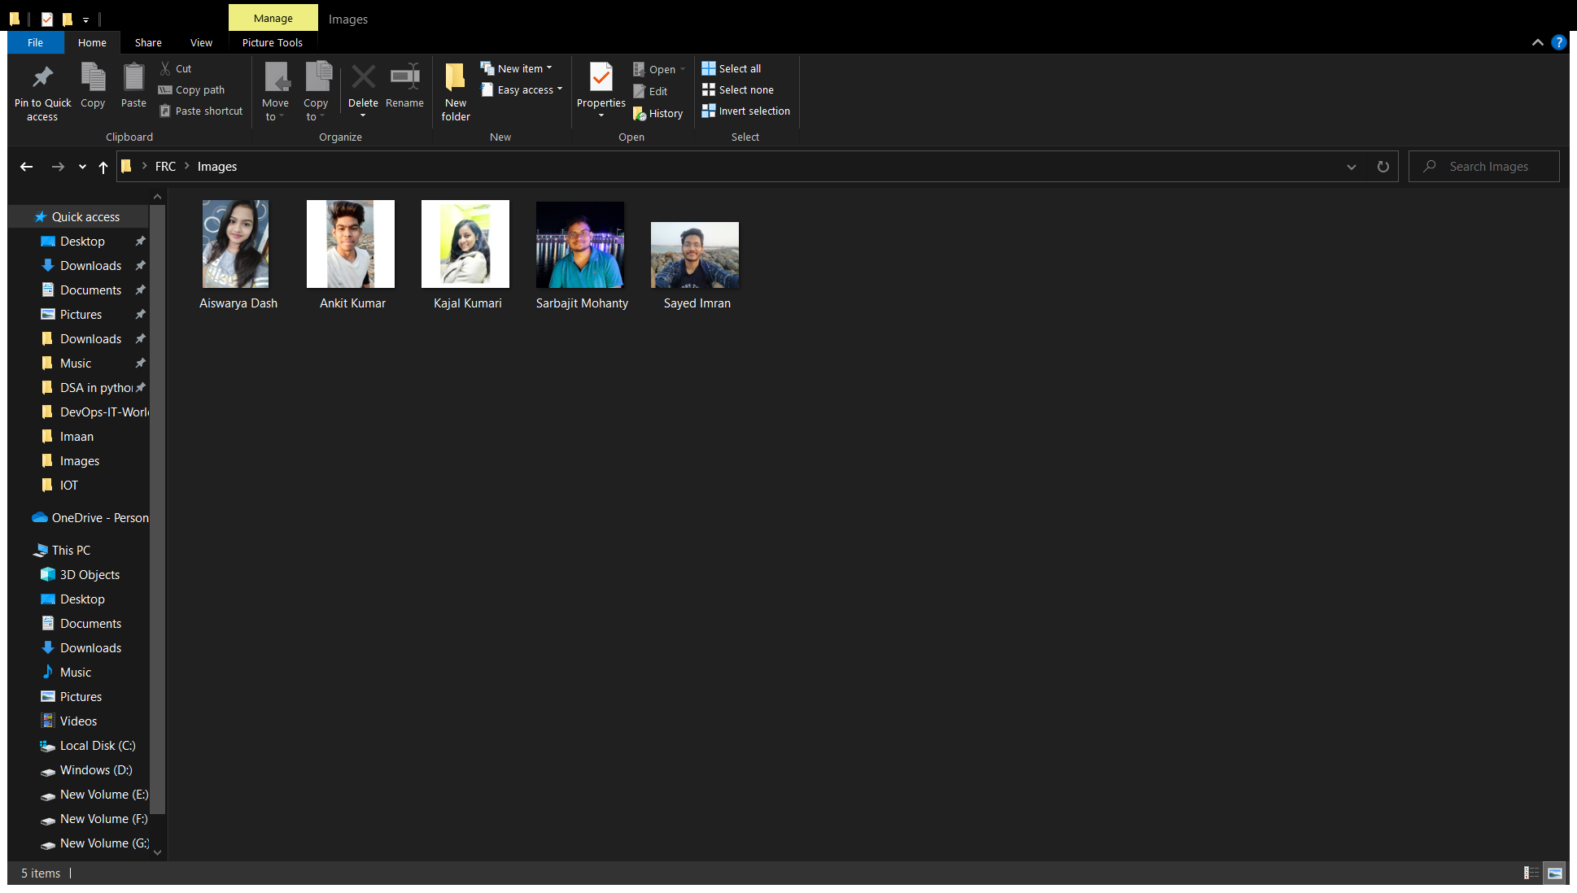
Creating Dataset
Image Data Collected using OpenCV

Slide 7
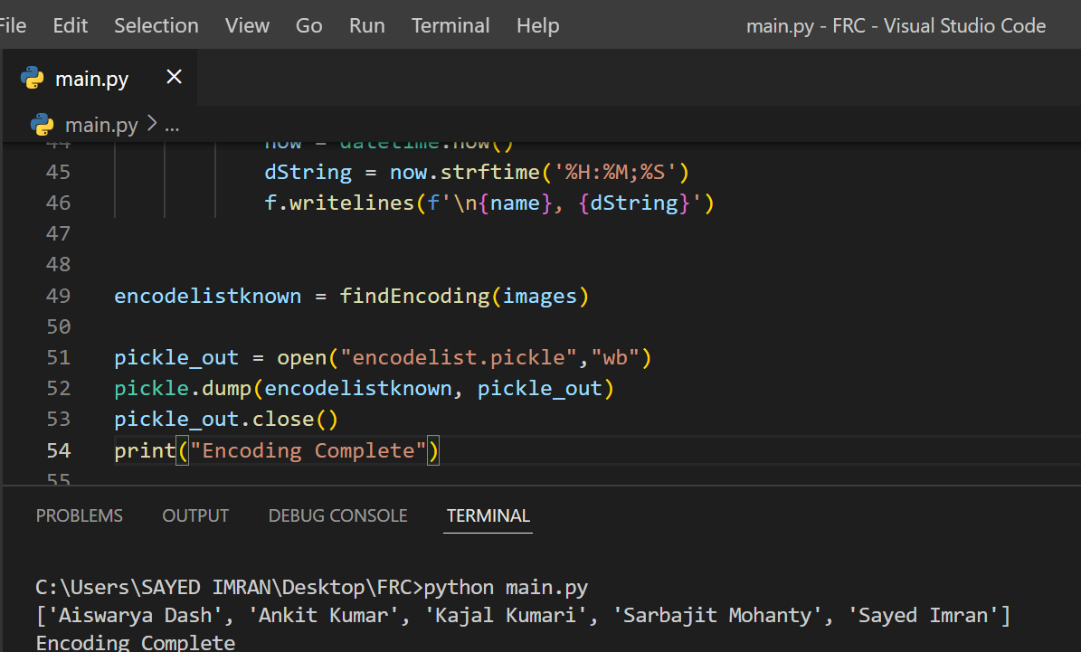
Encoding the Images of the Faces

Slide 8
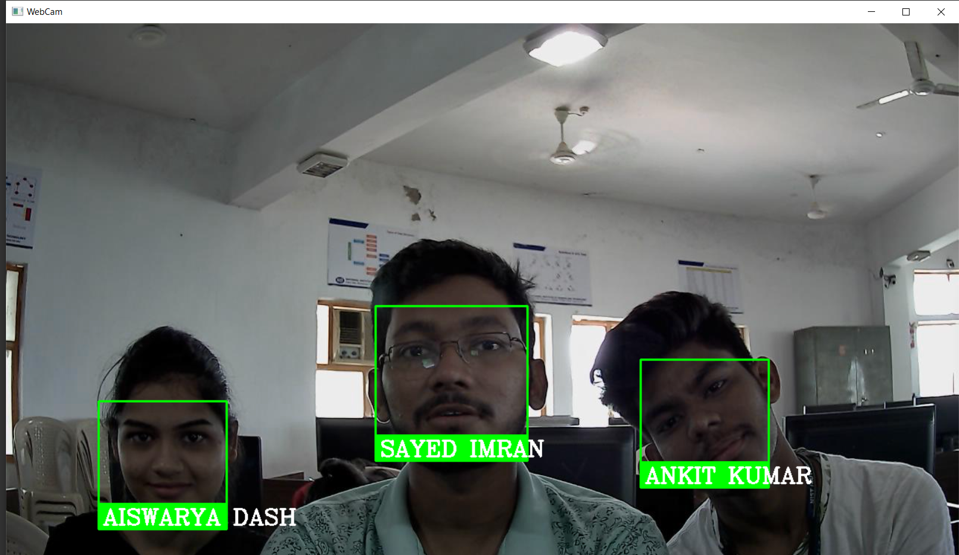
Multi-face Recognition using the Model

Slide 9
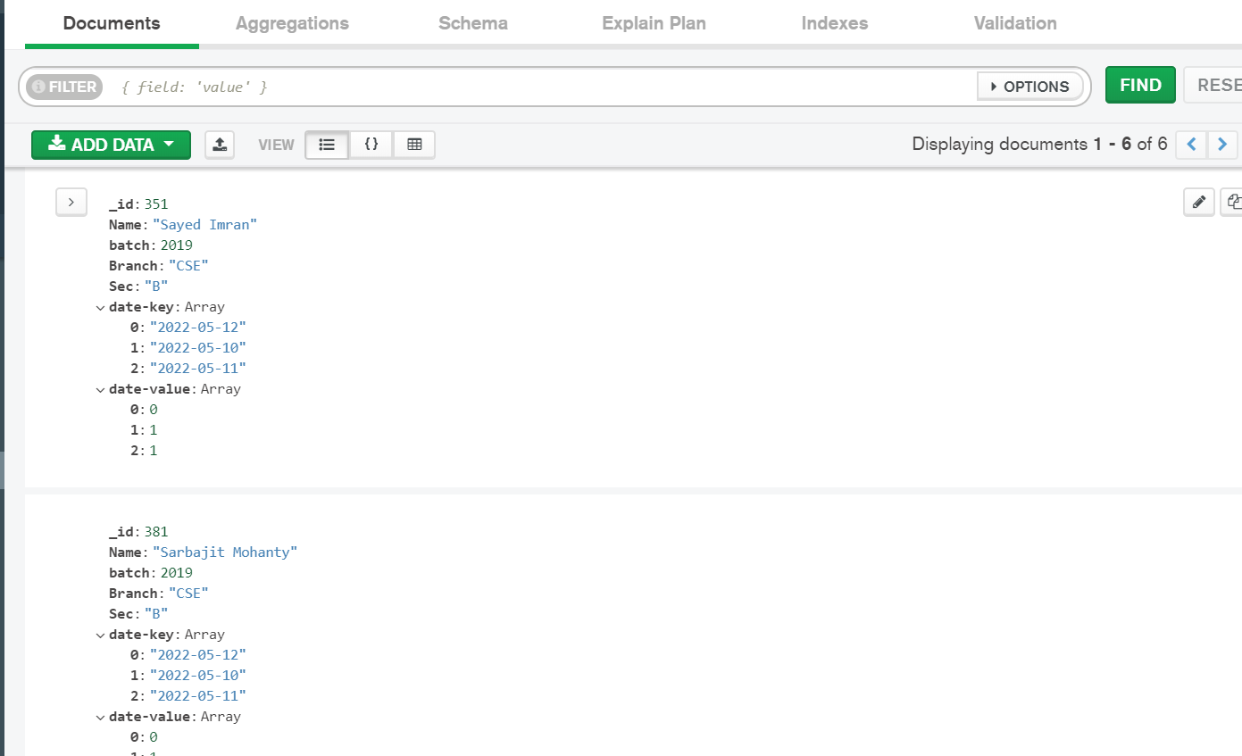
Data Stored in MongoDB Container in AWS Instance

Slide 10
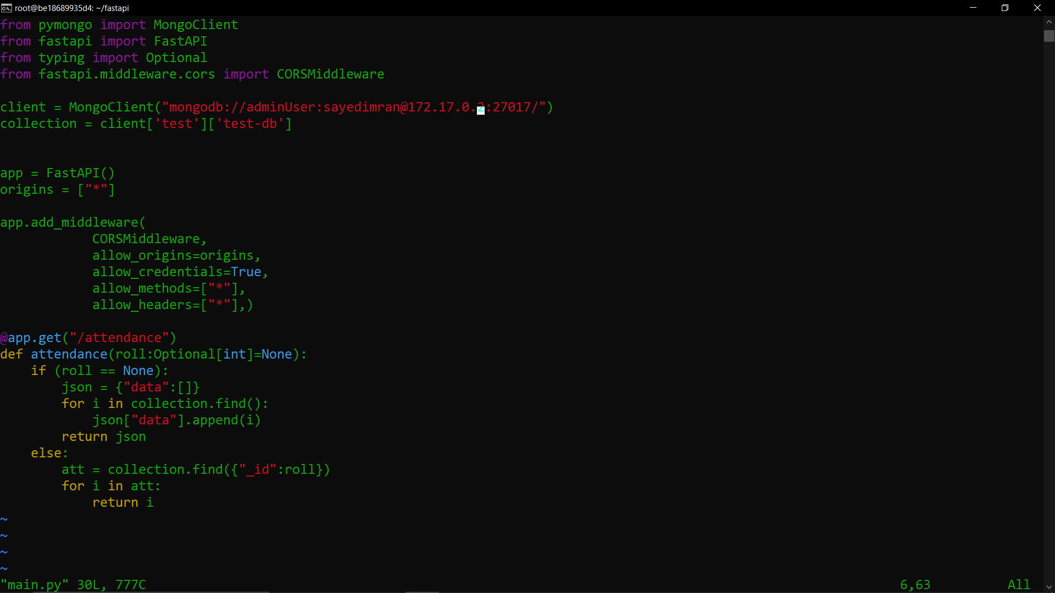
Fast-API backend that handles all operations

Slide 11
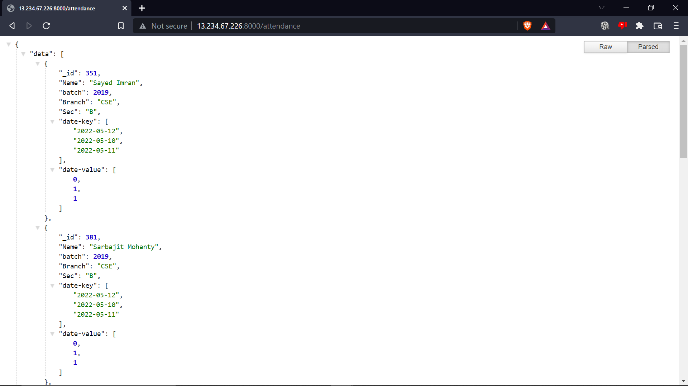
Data fetched from server that is hosted in a
docker container in an AWS instance

Slide 12
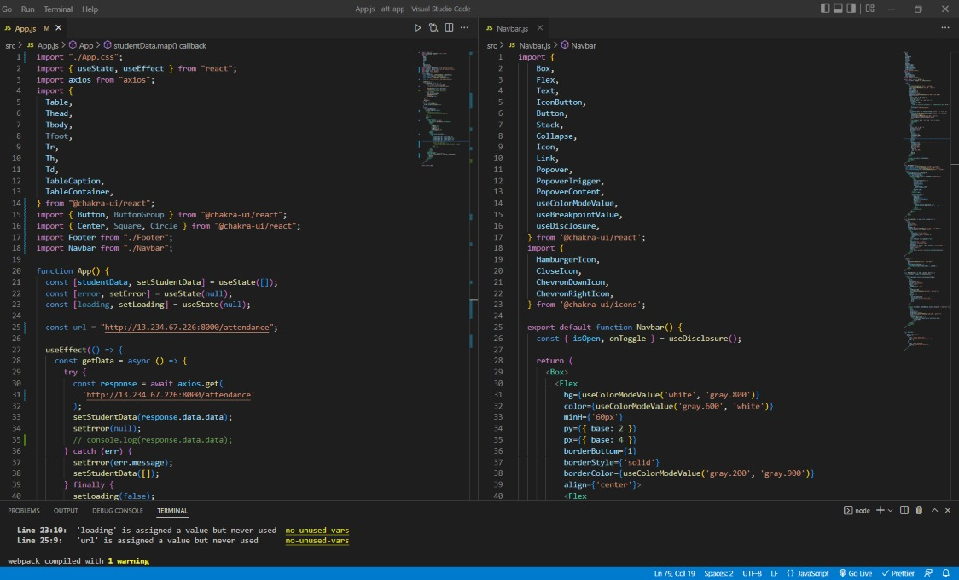
Front-end built using React and Component library: Chakra-UI

Slide 13
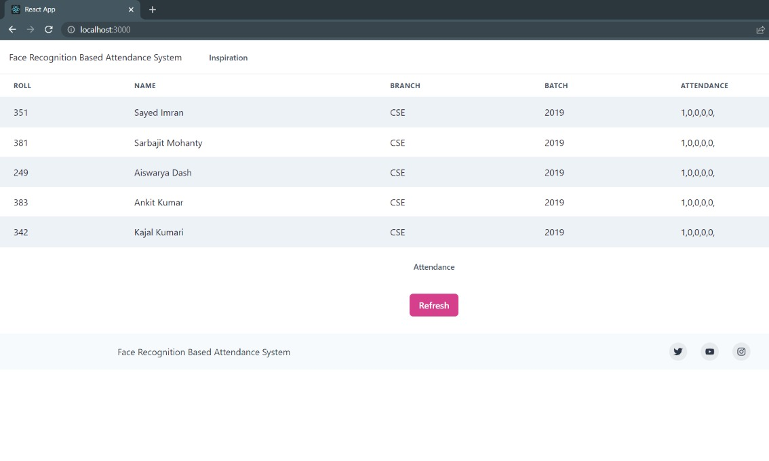
Dashboard for the same user interface

Slide 14
Thank You

